Slide 1
nVidia CUDA on GPU

Slide 2



Environment
http://colab.research.google.com/

Slide 3
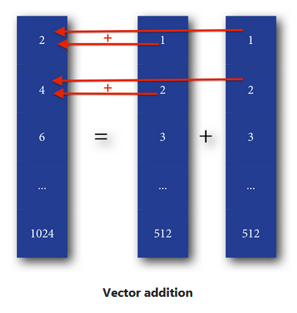
Vectors Addition Example
2 one-dimensional vectors A and B containing 512 cells(numbers) and result in vector C
Serial Processing
If you have fast CPU that can perform simple add in 1ns
So, we can compute all 512 addition operations in 512 ns
Parallel Processing
Modern GPU have thousands of slower processors for example each need 10ns to perform simple addition , as we only have 512 addition to do so, we can do all in parallel
Then all time needed will be 10ns

Slide 4
Parallel computing
Serial computing efficient for single task.
Parallel computing slower for single task but efficient to do thousands at a time
Types of parallelism
Task parallelism
Data parallelism

Slide 5
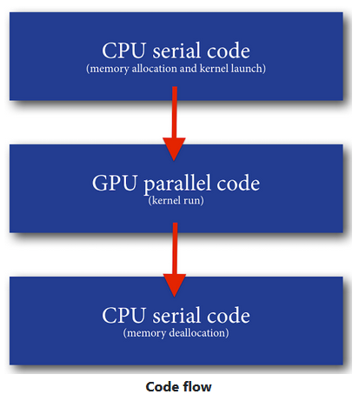
Structure of parallel program
C = A + B -> is a Task which have to perform 512 operations.
CPU task Called host task
GPU task Called device task
Code that will run on the GPU are called kernels
mark a method as a kernel, you apply the method decorator __global__ __

Slide 6
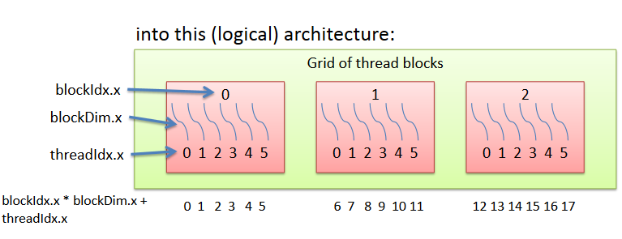
Structure of parallel program
Each kernel has a task to complete , do it using threads “sub task such as single addition”
Threads are grouped into blocks
Blocks contains up to 1024 thread ”multiplied by 32”
Blocks are grouped in grids

Slide 7


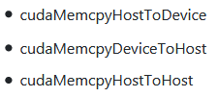
Memory allocation and transfer
This means that we are transferring from the h_A (host) location to d_A (device) location size bytes of data.

Slide 8

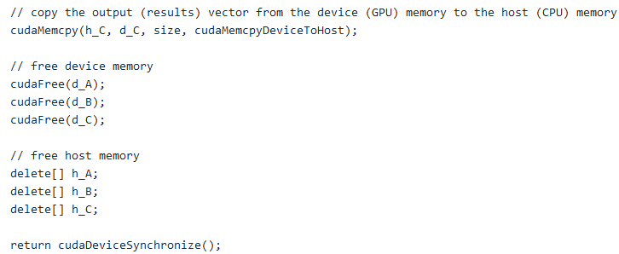
Kernel function invocation
GPU to CPU and memory deallocation

Slide 9
Assignment
https://sites.google.com/site/5kk70gpu/assignment-s/color-conversion
Today Resources: https://github.com/saraAwaad/CUDA_GPU

Slide 10
CUDA Installation
The NVIDIA GPU can be programmed using CUDA or OpenCL.
CUDA is the most common language
verify you have supported version of Linux
verify that gcc is installed
download and install Nividia driver and cuda software
verify installation
Running an example

Slide 11
Resources
https://devblogs.nvidia.com/even-easier-introduction-cuda/
https://developer.nvidia.com/cuda-downloads?target_os=Linux
https://sites.google.com/site/5kk70gpu/matrixmul-example
https://www.quantstart.com/articles/Vector-Addition-Hello-World-Example-with-CUDA-on-Mac-OSX
https://sites.google.com/site/5kk70gpu/installation
https://sites.google.com/site/5kk70gpu/assignment-s/color-conversion

